Slide 1

Math's 3
Playing with shapes

Slide 2

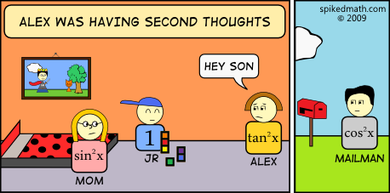
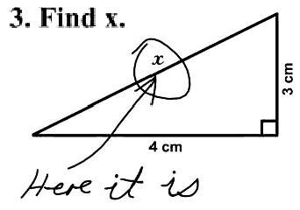
Shapes and Trigonometry

Slide 3
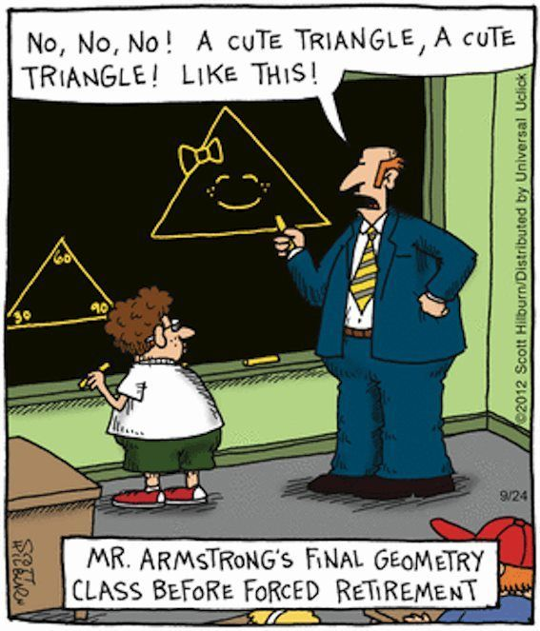
Perimeter, Area and Volume
Surprisingly many of the basic principles of maths are based on shapes and geometry.
Here we’ll do a quick recap of the basics of shapes.

Slide 4
Rectangles
Let’s look at a square

Slide 5
Perimeter
Let’s look at a square

Slide 6
Perimeter
Let’s look at a square
When we get measurements
of a shape we can use these to
get more information.

Slide 7
Perimeter
4
Let’s look at a square
When we get measurements
of a shape we can use these to
get more information.
Perimeter is the total length around
the outside of a shape.
4
4
4

Slide 8
Perimeter
4
To measure the perimeter we
simply add up the length of all
the sides.
4
4
4

Slide 9
Perimeter
4
To measure the perimeter we
simply add up the length of all
the sides.
4 + 4 + 4 + 4
4
4
4

Slide 10
Perimeter
4
To measure the perimeter we
simply add up the length of all
the sides.
4 + 4 + 4 + 4 = 16
4
4
4

Slide 11
Perimeter
4
To measure the perimeter we
simply add up the length of all
the sides.
4 + 4 + 4 + 4 = 16
Wasn’t that easy…
4
4
4

Slide 12
Perimeter
4
To measure the perimeter we
simply add up the length of all
the sides.
4 + 4 + 4 + 4 = 16
Wasn’t that easy…
4
4
4

Slide 13
Area
4
Area is the measurement of the
the total area the surface of the
shape covers.
4
4
4

Slide 14
Area
4
Area is the measurement of the
the total area the surface of the
shape covers.
Area is calculated by multiplying
two sides together
4
4
4

Slide 15
Area
4
Area is the measurement of the
the total area the surface of the
shape covers.
Area is calculated by multiplying
two sides together
4 x 4
4
4
4

Slide 16
Area
4
Area is the measurement of the
the total area the surface of the
shape covers.
Area is calculated by multiplying
two sides together
4 x 4 = 16
4
4
4

Slide 17
Area
4
Area is the measurement of the
the total area the surface of the
shape covers.
Area is calculated by multiplying
two sides together
4 x 4 = 16
Perimeter does not always = area!
4
4
4

Slide 18
Area
If your shape is a bit funky then
it is often possible to break it down
into multiple smaller shapes.
5
10
6
7

Slide 19
Area
If your shape is a bit funky then
it is often possible to break it down
into multiple smaller shapes.
3
4
5
10
6
8

Slide 20
Area
You now have two rectangles with
known measurements.
3
4
5
10
6
8

Slide 21
Area
You now have two rectangles with
known measurements.
3 x 4 and 6 x 8
3
4
5
10
6
8

Slide 22
Area
You now have two rectangles with
known measurements.
12 and 48
3
4
5
10
6
8

Slide 23
Area
You now have two rectangles with
known measurements.
12 and 48
Add them together to get the
total area
3
4
5
10
6
8

Slide 24
Area
You now have two rectangles with
known measurements.
12 and 48
Add them together to get the
total area
60
3
4
5
10
6
8

Slide 25
Circles!
This is a circle…
Geometry is a bit more complicated
with circles because there are no
obvious distinct sides.

Slide 26
Circles!
What we can measure is the longest
length across called the diameter.
d

Slide 27
Circles!
Another crucial measurement is the radius
this is half the diameter.
r

Slide 28
Circles!
The measurement of the perimeter of
a circle is called the circumference.
d
r

Slide 29
Circles!
The measurement of the perimeter of
a circle is called the circumference.
Circumference is related to the diameter
by a fixed constant called pi (π)
d
r

Slide 30
Circles!

Slide 31

Circles!
As π is a constant it does not change, this means we can work out the circumference of any circle based on the ratio of diameter and π with the formula:
$$c= πd$$
Where c is circumference and d is diameter.

Slide 32
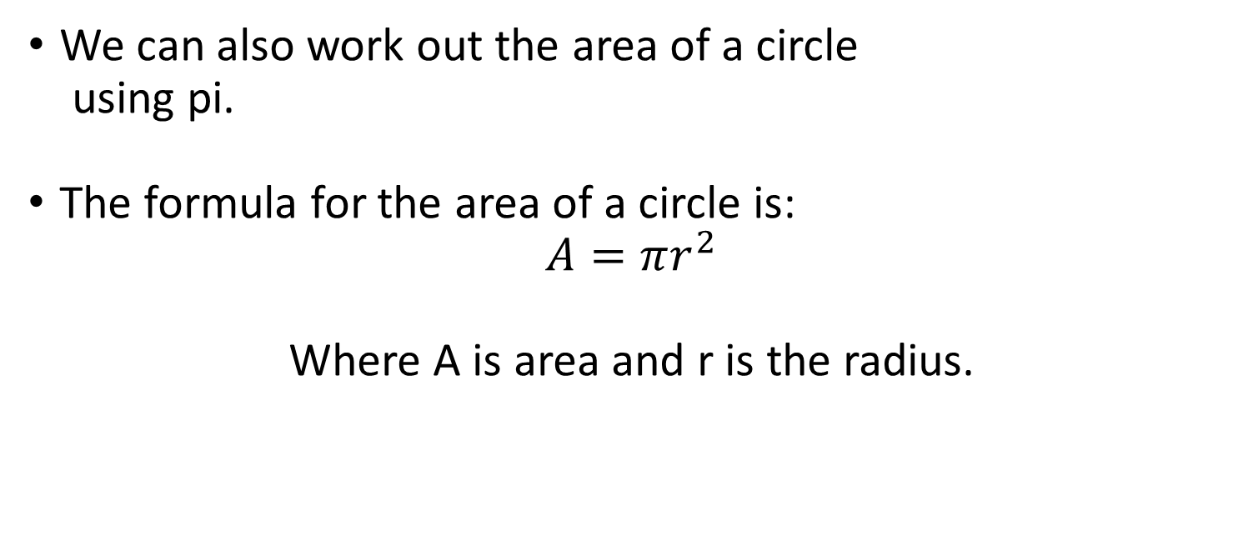
Circles!
We can also work out the area of a circle
using pi.
The formula for the area of a circle is:
$$A=πr^{2}$$
Where A is area and r is the radius.
d
r

Slide 33
Circles!
Lets try out one quickly.
A circle with diameter 16.
What is the circumference and area?
16

Slide 34
Circles!
Plug the numbers into the formula
Start with circumference
c=πd
16

Slide 35
Circles!
Plug the numbers into the formula
Start with circumference
c=π * 16
16

Slide 36
Circles!
Plug the numbers into the formula
Start with circumference
c= 3.14159 * 16
16

Slide 37
Circles!
Plug the numbers into the formula
Start with circumference
c= 3.14159 * 16
16

Slide 38
Circles!
Plug the numbers into the formula
Start with circumference
c= 50.27
16

Slide 39

Circles!
Plug the numbers into the formula
Now area
$$A=πr^{2}$$
16

Slide 40

Circles!
Plug the numbers into the formula
Now area
$$A=π8^{2}$$
16

Slide 41
Circles!
Plug the numbers into the formula
Now area
$$A=π8^{2}$$
16

Slide 42

Circles!
Plug the numbers into the formula
Now area
$$A=201.1$$
16

Slide 43
Circles! Radians and angles
Angles are the measurement of the
distance between two lines in relation
to a circular plane.
A complicated way to say an angle is an
angle.
d
r

Slide 44
Circles! Radians and angles
Angles are based on circles which means they involve pi.
Angles can be measured in radians and degrees, although most people use degrees!

Slide 45
Circles! Radians and angles

Slide 46
Circles! Radians and angles
1 radian is the angle that covers one radius length along the circumference of a circle
Degrees are a further breakdown of the angles of circles but still based on radians!
180° is π radians and 360° is 2 π radians.

Slide 47
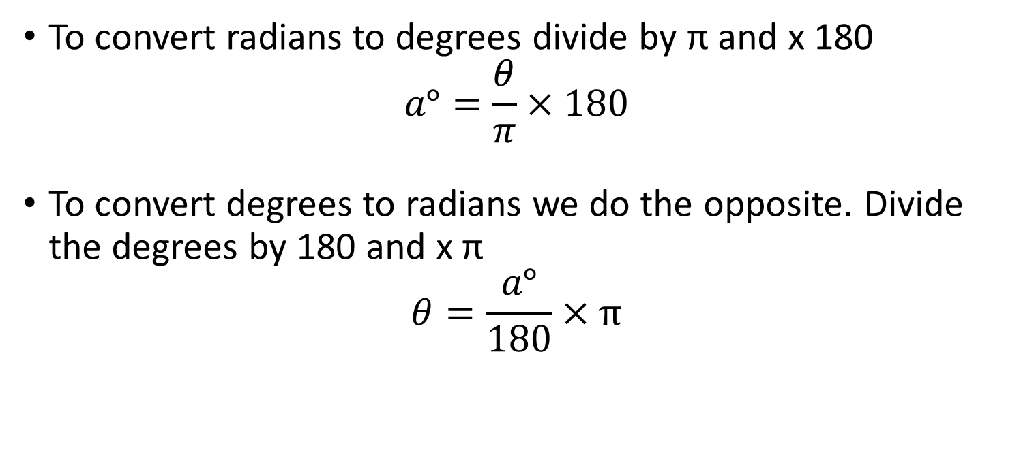
Circles! Radians and angles
To convert radians to degrees divide by π and x 180
$$a°=\frac{θ}{π}×180$$
To convert degrees to radians we do the opposite. Divide the degrees by 180 and x π
$$θ=\frac{a°}{180}×π$$

Slide 48
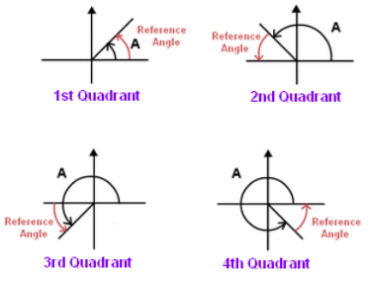
Circles! Reference Angles
Reference angles are the angle that is closest to the x axis.
These will become more important in trigonometry.

Slide 49
Triangles and Trigonometry
Now that we have covered shapes and angles we can get onto triangles.
First of all we will start with area again.

Slide 50
Triangles and Trigonometry
The formula for working out the area of a triangle is:
A= (b x h) / 2
Where is the length of the base and h is the height.

Slide 51
Triangles and Trigonometry
The formula for working out the area of a triangle is:
A= (b x h) / 2
Where is the length of the base and h is the height.
h
b

Slide 52
Triangles and Trigonometry
The formula for working out the area of a triangle is:
A= (b x h) / 2
Where is the length of the base and h is the height.
If you look at the rectangle you
can see a triangle is half a rectangle
so height is one edge and base is the
other, then it is only half.
h
b

Slide 53
Triangles and Trigonometry
A triangle is a shape with shockingly enough 3 angles…. Tri = three. These angles add up to 180 degrees.
A whole complex area of math has developed to understand the relationships between a triangles sides and angles.

Slide 54
Triangles and Trigonometry
We will start with a brief recap of Pythagoras.
Pythagoras’ theory applies to right angled triangles and allows you to work out the length of a side provided you have the length of two others.

Slide 55
Triangles and Trigonometry
A right angled triangle’s three sides have different names.
The side opposite the right angle is called the hypotenuse. The side opposite angle ѳ is the opposite and the side next to angle ѳ is the adjacent.
opposite
Hypotenuse
ѳ
Adjacent

Slide 56
Triangles and Trigonometry
To work out the length of a hypotenuse in a right angled triangle we use the formula a² + b² = c². Where a is the length of the opposite, b is the length of the adjacent and c is the length of the hypotenuse.
opposite
Hypotenuse
ѳ
Adjacent

Slide 57
Triangles and Trigonometry
Lets try one:
5
Hypotenuse
ѳ
8

Slide 58
Triangles and Trigonometry
Lets try one:
a² + b² = c²
5
Hypotenuse
ѳ
8

Slide 59
Triangles and Trigonometry
Lets try one:
5² + 8² = c²
5
Hypotenuse
ѳ
8

Slide 60
Triangles and Trigonometry
Lets try one:
25 + 64 = c²
5
Hypotenuse
ѳ
8

Slide 61
Triangles and Trigonometry
Lets try one:
89 = c²
5
Hypotenuse
ѳ
8

Slide 62

Triangles and Trigonometry
Lets try one:
$√$89 = c
5
Hypotenuse
ѳ
8

Slide 63

Triangles and Trigonometry
Lets try one:
$$c=9$$
5
Hypotenuse
ѳ
8

Slide 64
Triangles and Trigonometry
This formula can be rearranged so you can find the length of any of the sides if you know the length of two others.
opposite
Hypotenuse
ѳ
Adjacent

Slide 65
Triangles and Trigonometry
But what happens if you don’t know the lengths of the sides but you do know the angles?
Some clever clogs Greeks realised there is a fixed relationship between these things and thus trigonometry was born.
opposite
Hypotenuse
ѳ
Adjacent

Slide 66
Triangles and Trigonometry
But what happens if you don’t know the lengths of the sides but you do know the angles?
Some clever clogs Greeks realised there is a fixed relationship between these things and thus trigonometry was born.
opposite
Hypotenuse
ѳ
Adjacent

Slide 67
Triangles and Trigonometry
Because we know that the angles in a triangle add up to 180 degrees if we know any two angles in a triangle we can work out the third.
In a right angled triangle the two non right angles must add up to 90 degrees.
opposite
Hypotenuse
ѳ
Adjacent

Slide 68
Triangles and Trigonometry
Because we know that the angles in a triangle add up to 180 degrees if we know any two angles in a triangle we can work out the third.
In a right angled triangle the two non right angles must add up to 90 degrees.
opposite
Hypotenuse
ѳ
Adjacent

Slide 69
Triangles and Trigonometry
To relate the angles in a triangle to the lengths of the sides we have the trigonometric functions.
These are functions that when applied to an angle the results are equal to a ratio of the sides of a triangle.
opposite
Hypotenuse
ѳ
Adjacent

Slide 70
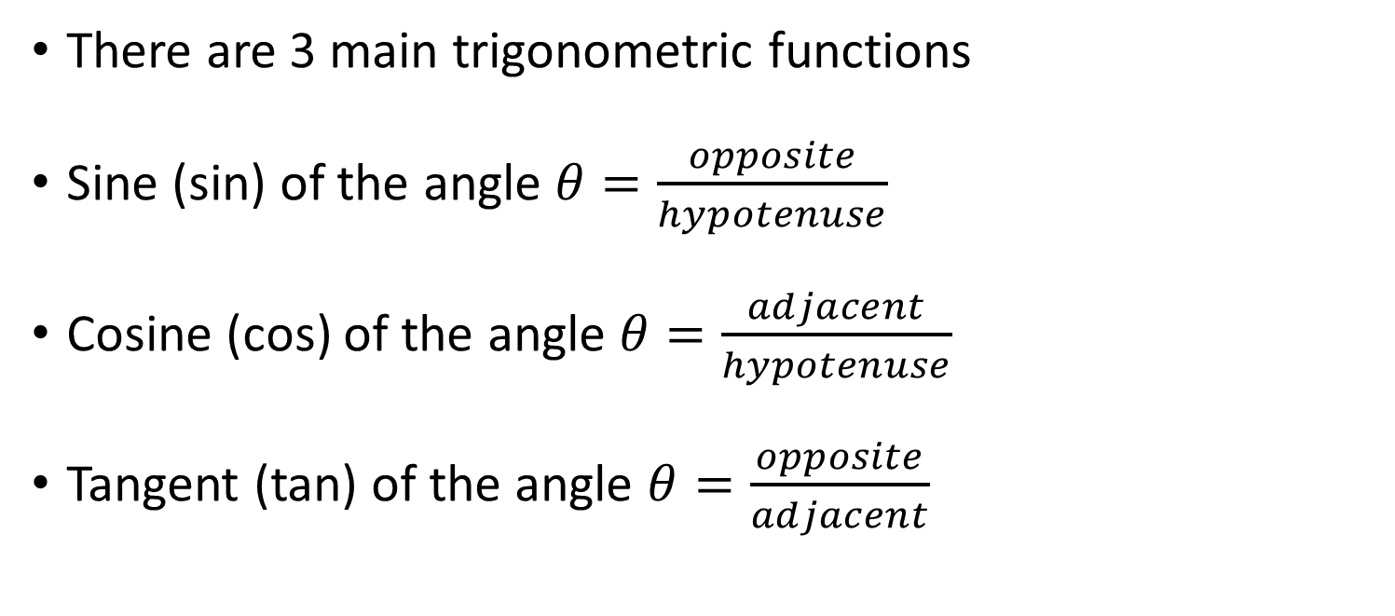
Triangles and Trigonometry
There are 3 main trigonometric functions
Sine (sin) of the angle $θ=\frac{opposite}{hypotenuse}$
Cosine (cos) of the angle $θ=\frac{adjacent}{hypotenuse}$
Tangent (tan) of the angle $θ=\frac{opposite}{adjacent}$
opposite
Hypotenuse
ѳ
Adjacent

Slide 71
Triangles and Trigonometry
The maths behind the functions themselves is incredibly complicated. I’ll not go into the details here.
If we know enough of the combination of side lengths and angles we can then work out all the rest of the measurements of a triangle.
opposite
Hypotenuse
ѳ
Adjacent

Slide 72
Triangles and Trigonometry
Lets try some:
opposite
25
26
Adjacent

Slide 73
Triangles and Trigonometry
Lets try some:
We know the hypotenuse
And the angle
opposite
25
26
Adjacent

Slide 74

Triangles and Trigonometry
Lets try some:
With $sinθ=\frac{opp}{hypo}$
opposite
25
26
Adjacent

Slide 75

Triangles and Trigonometry
Lets try some:
With $sin26=\frac{opp}{25}$
opposite
25
26
Adjacent

Slide 76

Triangles and Trigonometry
Lets try some:
With $0.44=\frac{opp}{25}$
opposite
25
26
Adjacent

Slide 77

Triangles and Trigonometry
Lets try some:
With $0.44 ∗25=opp$
opposite
25
26
Adjacent

Slide 78
Triangles and Trigonometry
Lets try some:
opp = 11
11
25
26
Adjacent

Slide 79
Triangles and Trigonometry
Shall we try back to Pythagoras and get the adjacent?
opp = 11
11
25
26
Adjacent

Slide 80
Triangles and Trigonometry
Shall we try back to Pythagoras and get the adjacent?
a² + b² = c²
11
25
26
Adjacent

Slide 81
Triangles and Trigonometry
Shall we try back to Pythagoras and get the adjacent?
b² = c² + a²
11
25
26
Adjacent

Slide 82
Triangles and Trigonometry
Shall we try back to Pythagoras and get the adjacent?
b² = 25² + 11²
11
25
26
Adjacent

Slide 83
Triangles and Trigonometry
Shall we try back to Pythagoras and get the adjacent?
b² = 625 + 121
11
25
26
Adjacent

Slide 84
Triangles and Trigonometry
Shall we try back to Pythagoras and get the adjacent?
b² = 746
11
25
26
Adjacent

Slide 85

Triangles and Trigonometry
Shall we try back to Pythagoras and get the adjacent?
b = $√$746
11
25
26
Adjacent

Slide 86

Triangles and Trigonometry
Shall we try back to Pythagoras and get the adjacent?
b = $27.31$
11
25
26
27.31

Slide 87
Triangles and Trigonometry
There are inverse functions of all the trigonometric functions that allow you to know what the angle is from a ratio of sides.
These are generally marked sin⁻¹, cos⁻¹, and tan⁻¹.
opposite
Hypotenuse
ѳ
Adjacent

Slide 88
Triangles and Trigonometry
Lets try one:
12
??
x
17

Slide 89
Triangles and Trigonometry
Lets try one:
Check which sides we have?
12
??
x
17

Slide 90
Triangles and Trigonometry
Lets try one:
We have opp and adj
12
??
x
17

Slide 91

Triangles and Trigonometry
Lets try one:
Tan(x) = $\frac{o}{a}$
12
??
x
17

Slide 92

Triangles and Trigonometry
Lets try one:
x = Tan⁻¹ ( $\frac{o}{a})$
12
??
x
17

Slide 93

Triangles and Trigonometry
Lets try one:
x = Tan⁻¹ ( $\frac{12}{17})$
12
??
x
17

Slide 94

Triangles and Trigonometry
Lets try one:
x = Tan⁻¹ ( $0.71)$
12
??
x
17

Slide 95
Triangles and Trigonometry
Lets try one:
x = 35.37°
12
??
x
17

